Slide 1
Survey Results

Slide 2

Team members :
Mahmoud Reda Farouk
Mahmoud Basuni Mansour
Mahmoud Hamdy Mahmoud
Hager Nabil
Khadija Serag Hamd
May Esmail Mohamed

Slide 3
Papers summary
Let’s start with the first set of slides

Slide 4
“ Mahmoud Reda Farouk ”

Slide 5
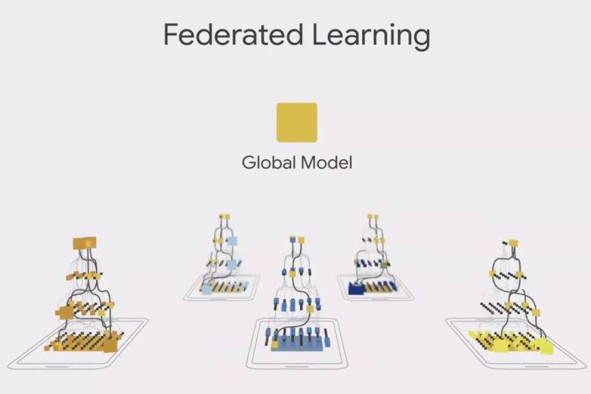

Slide 6
“Real-World Image Datasets for Federated Learning: object detection using YOLO and Federated Learning ”
1
Year: 2019

Slide 7
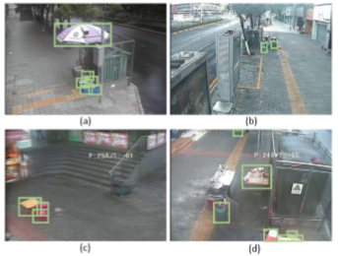
Algorithms:
Fast R-CNN.
YOLO.
Federated Learning algorithms (LSTM, SVMs).
Federated Average.
Data set :
26 street monitoring videos.
956 images(765 for training 80%, 191 for testing 20%)
Result :
YOLOv3 , Federated Average model reaches 88.86% mAP after1400 rounds, which is the best performance of centralized training.
Fast R-CNN, Federated Average model eventually reach almost the same performance of centralized training.
The size of the parameters of Faster R-CNN (heavy) is more than twice that of YOLOv3 (light).
Conclusion:
release a real-world image dataset to evaluate federated object detection algorithms, with reproducible benchmark on Faster R-CNN and YOLOv3. common object categories on the street, which are naturally collected and divided according to the geographical information of the cameras.

Slide 8
“Lifelong Federated Reinforcement Learning: A Learning Architecture for Navigation in Cloud Robotic Systems”
2
Year: 2019

Slide 9
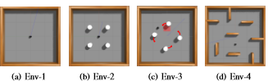
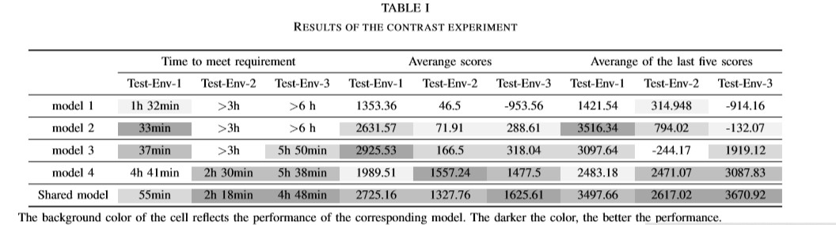
Algorithms:
Lifelong Federated Reinforcement Learning
Knowledge fusion algorithm
a new transfer learning approach
Data set :
An episode is terminated after the agent either reaches the goal, collides with an obstacle, or after a maximum of 6000 steps during training and 1000 for testing.
Conclusion:
We presented a learning architecture LFRL for navigation in cloud robotic systems. The architecture is able to make navigation-learning robots effectively use prior knowledge and quickly adapt to new environment.

Slide 10
“Differential Privacy-enabled Federated Learning for Sensitive Health Data”
3
Year: 2019

Slide 11
Algorithms:
federated learning
Differential Privacy
Perceptron
support vector machine (SVM)
logistic regression
Data set :
we used Limited Market Scan Explores Claims-EMR Data (LCED), which comprises administrative claims and electronic health records (EHRs) of over 1 million commercially insured patients. It consists of patient-level sensitive features, such as demographics, habits, diagnosis codes, outpatient prescription ﬁlls, laboratory results, and inpatient admission records.
Result:
we measure their utility in terms of F1 score. The models were trained on 70% of the data with 5-fold cross validation. FL achieves comparable performance to centralized learning for both tasks of ADR and mortality prediction. Although differential privacy guarantees a given level of privacy.
Conclusion:
We further explored the potential of differential privacy in preserving the privacy of federated learning models, while maintaining high model performance in the context of real-world health applications. Through experimental evaluation, we show that although differential privacy is being readily adopted in a federated setup, it can lead to a signiﬁcant loss in model performance for healthcare applications

Slide 12
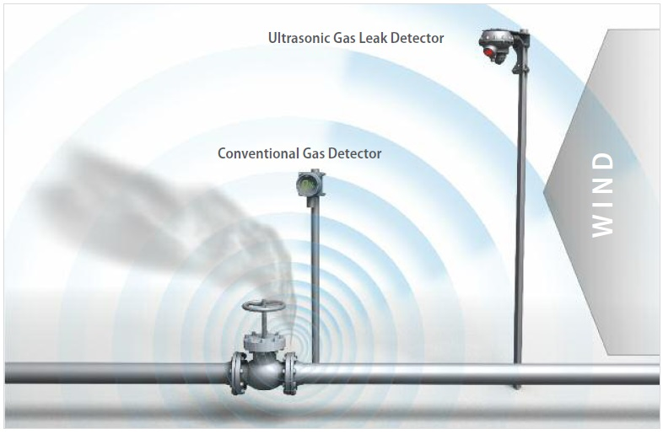

Slide 13
“Gas Leak Detection in Pipelines & Repairing System of Titas Gas ”
1
Year: 2014

Slide 14
Algorithms:
three categories: biological methods, non-optical methods and optical methods.
biological methods:{Odor, sound, dogs, Soap Screening, insects, Fungus-like Growth, vegetation},
on optical methods: {acoustic method, Gas sampling, Soil monitoring, Ultrasonic flow meters, Software-Based Methods, Magnetic Flux Leakage (Pigging) Method,.... }.
optical method: { Active methods, Passive methods }
Data set :
pipelines under the ground and in the plant also under the cities. and across countries.
Result :
there is advantage and disadvantage of each method, sometimes too much cost with high quality sometimes less cost with medium quality and etc..
Conclusion:
Leak detection techniques have both advantages and disadvantages. Ineffective biological methods are used Gas to detect gas leakage. But this method is not enough to identify a potential leak by keeping the environment in good condition.

Slide 15
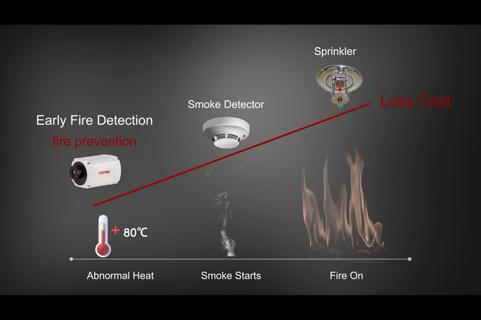

Slide 16
“FIRE DETECTION USING COMPUTER VISION MODELS IN SURVEILLANCE VIDEOS”
1
Year: 2017

Slide 17
Algorithms:
Coloring models (RGB- HSI)
Gaussian Mixture Model (GMM)
Geometrical Independent Component Analysis (GICA) model.
Data set :
CC video outdoor and indoor with different shapes of fire, different illumination and different time (morning and night).
Result :
The target tracking and recognition method successfully track the fire.
The minimum time taken for fire detection is <= 4.1s.
for visual appear the RGB model is good because the red rectangle cover the result in other models.
the best model is GMM but it's slow.
GCIA model is the best in time and accuracy near to GMM.
Conclusion:
All the three models work good HSI is better than RGB in result at night, but in box detection the RGB appear better. GMM is very good at detection but slow the GCIA is the best one.

Slide 18
“COMPUTER VISION BASED SMOKE DETECTION METHOD BY USING COLOUR AND OBJECT TRACKING”
2
Year: 2016

Slide 19
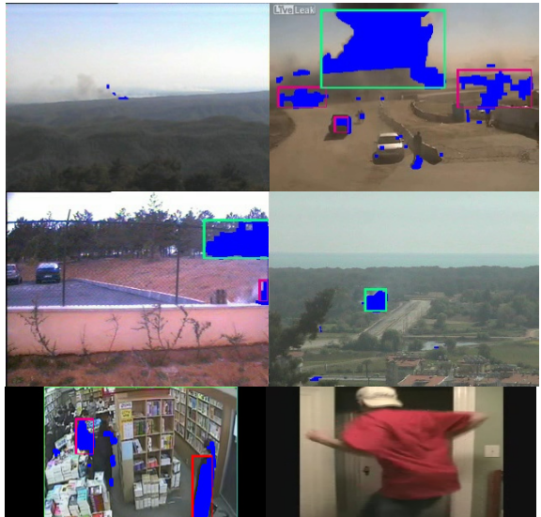
Algorithms:
Open filter
Close filter
smoke features like (motion(going upward in frame) - disappearing - local brightness).
Data set :
CC video outdoor and indoor with different shapes of fire, different illumination and different time (morning and night).
Conclusion:
smoke detection method is proposed to decrease the false detection for better use in real. To reduce the false detection rate, we use labelling and object tracking that can monitor behavior of each object. By monitored data, smoke object is determined as smoke when all movement and characteristic are satisfied to decide. however in some unexpected condition there are still some errors

Slide 20


Slide 21
“Underwater Image Processing And Object Detection Based On Modified YOLO Method ”
1
Year: 2019

Slide 22
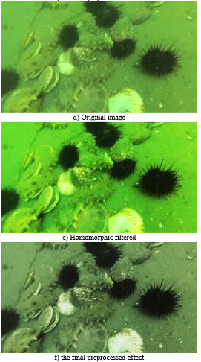
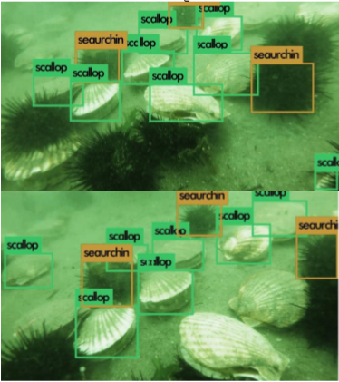
Algorithms:
YOLOv3.
Homomorphic filter.
Loss function
CNN.
Data set :
17000 image under the water.
Result :
Conclusion:
in this paper all image processing enhancement and yolov3 methods is used to realize some object under the see the result is very good almost
all of the targets
can be detected by the program
except few little details

Slide 23
“You Only Look Once: Uniﬁed, Real-Time Object Detection”
2

Slide 24
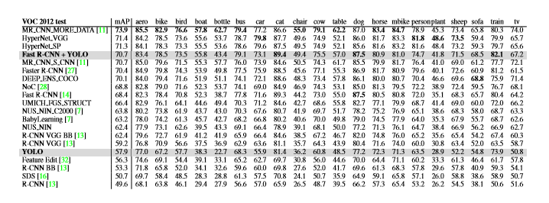
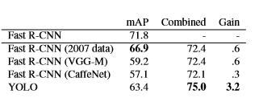
Algorithms:
YOLO
Fast R-CNN
Data set :
PASCAL VOC 2012 , VOC 2007, ImageNet ,GoogleNet, The Pascal Visual Object Classes (VOC).
Result :
Conclusion:
Fast YOLO is the fastest general-purpose object detector in the literature and YOLO pushes the state-of-the-art in real-time object detection. YOLO also generalizes well to new domains making it ideal for applications that rely on fast, robust object detection.

Slide 25
“ Mahmoud Basuni Mansour ”

Slide 26
FedHealth: A Federated Transfer Learning Framework for Wearable Healthcare 2018
1

Slide 27
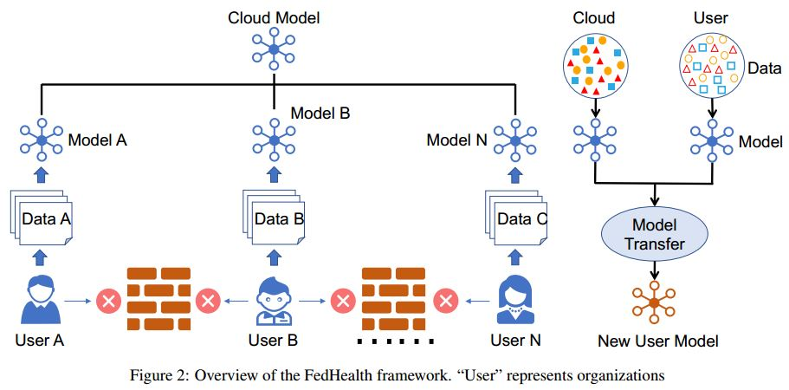
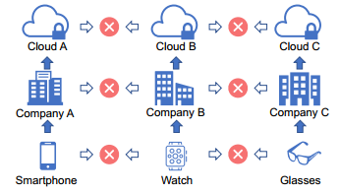
Description:

Slide 28
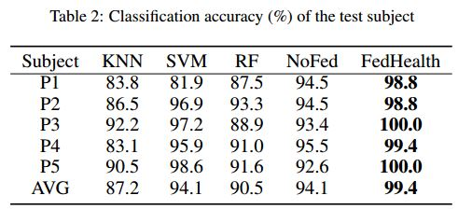
Algorithms:
Federated Learning ,homomorphic encryption ,convolutional neural network (CNN)
Support Vector Machines (SVM), Decision Tree (DT), and Hidden Markov Models (HMM) , KNN (K nearest neighbors) and RE(random forest) to compare results.
NoFed :mean using only sever model in training with deep methods (using neural networks such as CNN)
Data set :
public human activity recognition dataset called UCI Smartphone. 6 activities collected from 30 users. There are 10,299 instances in total.(5 isolated P1 – P5)
Results:
FedHealth dramatically improves the recognition accuracy by 5.3% compared to traditional learning approaches .
Conclusion :
FedHealth make Upswing in accuracy
comparing to other traditional methods.
Use different technique instead CNN to
improve accuracy more and more.
FedHealth adopted to new techniques.

Slide 29
Wild land Forest Fire Smoke Detection Based on Faster R-CNN using Synthetic Smoke Images 2017
2

Slide 30
Algorithms:
Faster R-CNN:
Function model they select is Zfnet
Data set :
Real smoke + forest background :12620 forest background images at random positions with deformation
Simulative smoke + forest background:12620 forest background images.
Results:
(Real ,Synthetic Smoke Model ):93.67 % to 99.94% . Real Video image:51.84% to100%
Conclusion:
solve the problem of data lack in data sets used in fire detection systems.
high Detection Rate and accuracy prove that Synthetic images is so helpful and needed .

Slide 31
Availability data set of Fire images for training deep models are limited in scale and diversity for most problems and models. Proposed approach produce synthetic forest smoke images by inserting two kinds of smoke. Real smoke and simulative smoke, into forest background. Using (Faster R-CNN+Function model Zfnet) to test detection of fire with new data set with high detection rate of simulated model.

Slide 32
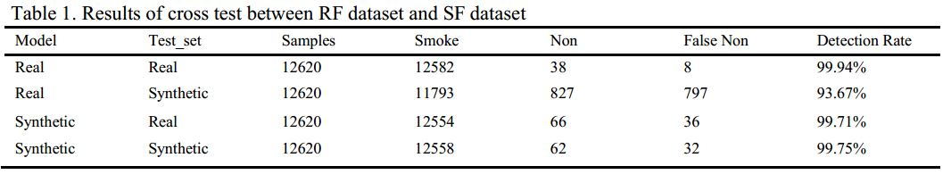
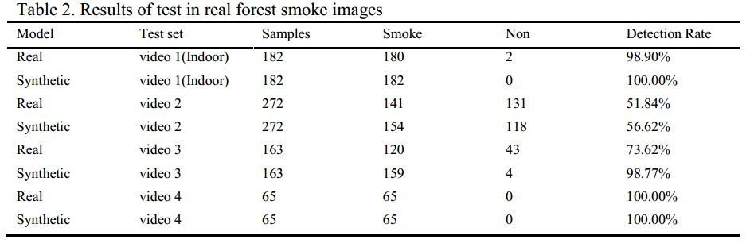
Results :

Slide 33
Machine Vision for Natural Gas Methane Emissions Detection Using an Infrared Camera 2019
3

Slide 34
Algorithms:
Different background subtraction methods : fixed ,moving average
Convolutional Neural Network ( CNN )
optical-flow based change detection algorithm
(Asses ability CNN result with baseline method)
Data set:
they collected a total of 31 “24-min” videos at separators, Datasets-GasVid.
Respect to 5 imaging distances in total: 4.6 m, 6.9 m, 9.8 m, 12.6 m and 15.6 m. Within the 24-min-vide
Result :
the overall detection accuracy can exceed 95% for a case across all leak sizes and imaging distances.
Conclusion :
Have a great accuracy for different cases for camera and leak condition according to use camera instead sensor for far areas.
High cost for IR camera for using more than one to cover all areas of building
test another technique for training model to reach more in accuracy like Fast-RCNN.

Slide 35
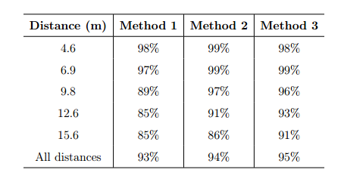
Results :
Method 1: train 35 models, one for each distance and leak size combination.
Method 2: train 5 models, one for each distance with all leak sizes.
Method 3: train 1 model for all combinations of leak size and imaging distance.

Slide 36
Leak detection of pipeline: An integrated approach of rough set theory and artificial bee colony trained SVM 2012
4

Slide 37
Algorithms:
Rough set theory data mining technique.
Support vector machine (SVM)
artificial bee colony algorithm (ABC): (Developed swarm intelligence technique) used to find potential region of solution. it has been used and performance was compared with PSO and its variant EPSO.
Data set:
five flow variables inlet pressure, inlet flow rate, outlet pressure, outlet flow rate, and difference of flow rates.
200 cases were generated by the described method.
110 abnormal cases have leak and 90 normal doesn’t have leak
Results :
ABC detected 99 leaks with accuracy of 95.19% whereas PSO and EPSO detected 90 leaks with accuracy of 86.54%.

Slide 38
Conclusion :
It is very useful in both the places where mass balance and pressure point analysis techniques are especially utilized.
Experiment need more measures to be in consideration like location and size of leak and response time of technique didn’t get in results.

Slide 39
Gas Leak Detection and Avoidance using ARM 2018
5

Slide 40
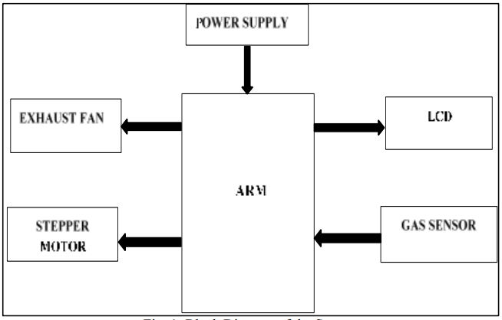
Model of system: (Figure)
Data set:
System takes data from MQ-6 sensor
to detect LPG gas existence
and its level by comparator .
Results :
System takes an automatic control action after the detection of 0.001% of LPG leakage.
Conclusion :
Detect LPG gas and take action to avoid disasters happen from leakage by more than one method.
But need more information about dataset and experimental results.
Its needed future work is add GSM module to notify consumer.

Slide 41
Hazardous gas detection and notification system (IOT based system) 2018
6

Slide 42
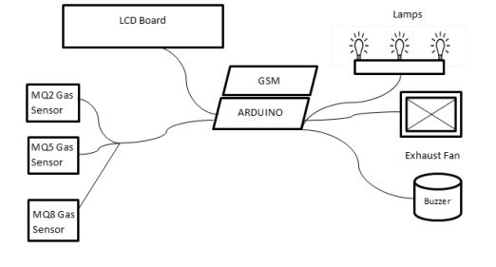
Model of system :
MQ2 sensor propane/butane gas (LPG)
MQ5 sensor methane gas
MQ8 sensor hydrogen gas

Slide 43
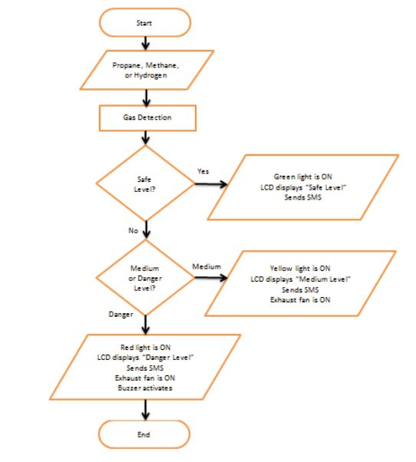
Description:

Slide 44
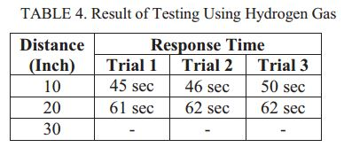
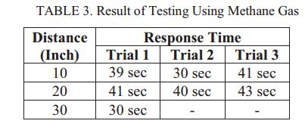
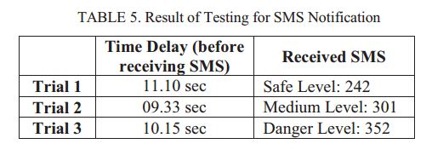
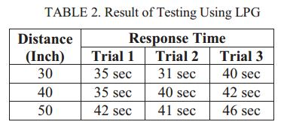
Results :

Slide 45
Conclusion :
more than one method for action and use GSM module Make it better IOT System.
LPG sensor have best result from far distance
Hydrogen sensor have less accuracy compared to others with medium accuracy for methane sensor
the experiment success with shown results which good one but need to reduce delay/response time more. If we have large area and want to cover it we will need large number of sensor with high cost.

Slide 46
Fast Object Detection at Constrained Energy 2018
7

Slide 47
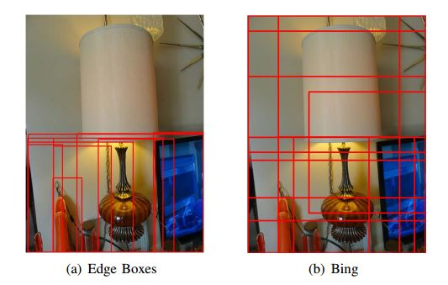
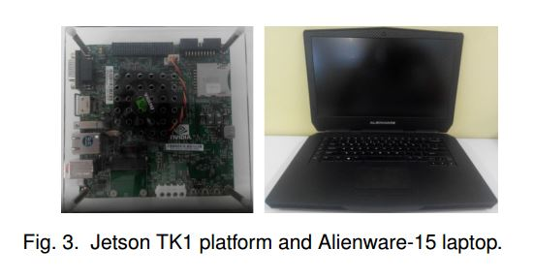
Algorithms and models :
Fast-RCNN Framework
Generating Proposals via Bing and Edge boxes
perform experiment with Jetson TK1 SOC platform and the Alienware- 15 laptop
Data set :
They use the detection training data from ILSVRC 2014, which has over 450,000 images and 200 common categories.

Slide 48
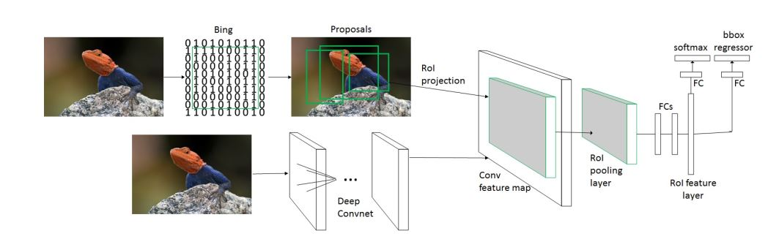
Results :
Performance of object detection is measured by mAP/E. Here E is the total energy consumption. mAP(mean Average Precision) is the commonly used measurement in the computer vision community, denoting the mean across object categories of the average precision for detection of that category (ROI) Region of interest
ROIP 2x2 = Model S , ROIP 6x6 = Model M , ROIP 7x7 = Model L

Slide 49
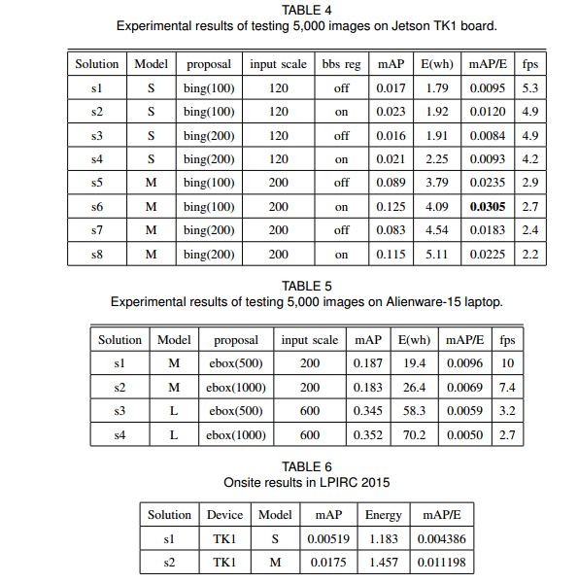
Results :
The best result show that we achieve a mAP/E of 0.0305 on Jetson TK1.
Low Power Image Recognition Challenge (LPIRC): transmission of input images and results to the server in 10-minutes bbs reg :bound boxes regression bing(100),ebox(500): number of proposals in image
Image input scale

Slide 50
Result Conclusion:
Table 1
Less proposals are better than more.
Bounding box regression helps (solution with it is better).
Med-size networks are better than small-size network .
Solution s6 achieves the highest mAP/E with 0.0305 .
Table 2
Alienware-15 is less cost effective than Jetson TK1.
Less proposals are as good as more.
Med-size networks are more cost effective than Large-size ones.
Tips:
Use less proposals and median to small size of ROIP(Region of Interest Pooling layer ) as you can are more effective to balance between accuracy and energy

Slide 51
Conclusion :
they conclude how to obtain good balance between accuracy and energy cost, which might provide guidance to design effective and efficient object detection models on specific devices you want.
More techniques could be explored to optimize the network structure than Fast-RCNN.

Slide 52
A proposed approach investigate various combinations of object proposal and object representation to get the balance between accuracy and energy consumed in used device. With useful observations such as Use less proposals and median to small size of ROIP(Region of Interest Pooling layer ) which is possible valuable for academy and industry in designing object detection models on mobile devices.
The best result show that we achieve a mAP/E of 0.0305 on Jetson TK1 with good balance between accuracy and energy cost.

Slide 53
A survey on gas leak detection and localization techniques. 2012
8

Slide 54
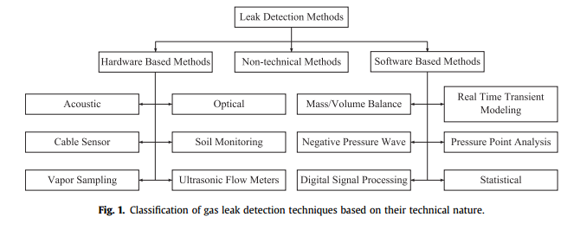
Algorithms and models:
انى أقيم النتائج الى حصلت قبل كدا ومن خلالها اقدر احدد اذا كان في تسريب ولا لا فعلا بسبب الحالات الخطأ الى بتحصل من انى مجرد بشوف الكميات الى داخلة وخارجة
صوتي
استخدام اسلاك الفايبر او نوع معين من الاسلاك بيكون حساس للمواد الكيميائية وبتغير بتغير خواص المواد دي
انخفاض الضغط
انخفاض الضغط
Mass balanced
مدى استجابة النظام للترسيب system response also measured in this technique

Slide 55
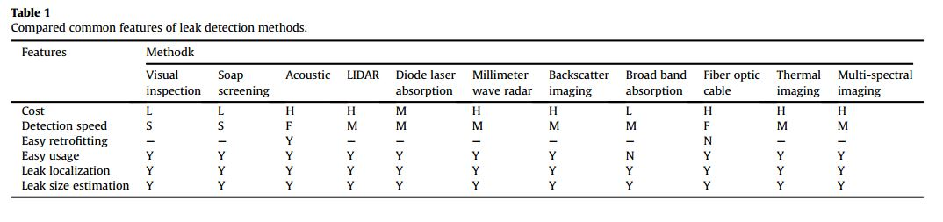
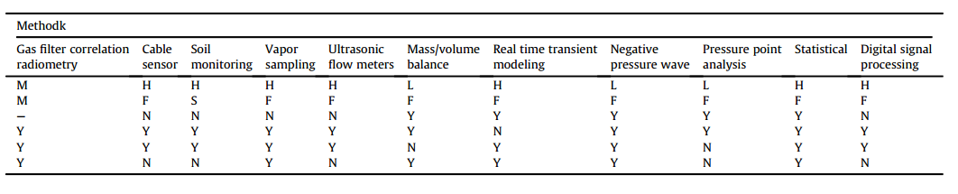
Comparing Results : yes (Y), no (N), slow (S), medium (M), fast (F), low (L) and high (H)

Slide 56
Conclusion :
A wide variety of leak detecting techniques is available for pipelines like shown in table1 each one for common use and has its advantages and disadvantages so we select the best based on problem condition if it in small place and just small pipes it can be handled by non technical or hardware based for better performance

Slide 57
“Mahmoud Hamdy Mahmoud ”

Slide 58
Title: Deep Learning Based Fire Detection System Algorithm: 2018 D-CNN (Deep Convolutional neural networks), computer vision system employs three major stages: (1) moving object segmentation, (2) fire pixel detection (3) analysis of the candidate regions containing fire pixels. Data set : Uses a mixture of Gaussian distribution which are obtained from a training set of fire pixels represented in the RGB color space, also using Resnet 50 and VGG16 dataset Result: after using this system that detect the fire as early as possible this can provide enough time for automated systems/ fire personnel for effective counter actions. Conclusion: This paper proposed a video-based fire alarming system by analyzing the image sequences acquired from a video source. The fire can be detected at its inception.
1

Slide 59
Title: Remote Leak Hole Localization for Underwater Natural Gas Pipelines
Algorithm: 2017
Leakage can be detected by using software based methods.
GAS BUBBLES IN UNDERWATER MEDIUM,
LEAK HOLE LOCALIZATION METHOD
Dataset:
Sources of underwater ambient noise by Gaussian distribution and thermal noise (Nth)
Result:
Leakages can be located with low average position errors far from several kilometers depending
on underwater ambient noise, detection method and source strength.
Conclusion:
The proposed system can detect the leak of pipelines underwater and provide its location
and size of leak hole remotely.
2

Slide 60
Title: Detection Of Fire Using Morphological Process In Real Time-datacenter
2018
Algorithm :
Neural network , Spatio-temporal algorithm , YCbCr Color Space , Morphological Process.
Dataset : MIVIA dataset
Result:
This project is used in real time applications, online video frames are processed using camera.
Once it is detected, fire alarm generated.
Conclusion:
This approach can be used in server rooms, datacenter, banks, etc.
Since above mentioned rooms are highly secured.
3

Slide 61
Title: Wireless Sensor Networks based Pipeline Vandalisation and Oil Spillage Monitoring and Detection 2015 Algorithm: Radio Frequency Identification (RFID), Global Positioning System (GPS), General Packet Radio Service (GPRS) and Wireless Local Area Networks (WLAN). Result: Industrial player, government, organizations in oil and gas, environment and researchers can use the benefits of wireless sensor networks in pipeline vandalisation monitoring and oil spillage detection. Conclusion: Wireless sensor networks which can be used to obtain timely information on pipeline vandalisation and oil spillage can help in mitigating their negative effectives on the environment.
4

Slide 62
Title : Real Time Fire and Smoke Detection using Multi-Expert System
Algorithm: 2016
Moving Object Detection, Color Evaluation (CE),
Movement Evaluation (ME), Shape Evaluation (SE).
Dataset: Mivia dataset which have videos of fire and smoke in different conditions in different places.
Result:
This method for real time fire detection for video-surveillance applications using a combination of
experts based on color, shape, and motion. That method was comparatively high performance.
the result of color evaluation gives the perfect accuracy.
Conclusion:
Well maintained and correctly operating systems are effective and can reduce a number loss due to this fire.
The performance and efficiency of this method is high,
due to it takes the combination of different aspects of fire.

Slide 63
Title : Automatic Reaction to a Chemical Event Detected by a Low-cost
Wireless Chemical Sensing Network
2009
Algorithm:
EVENT DETECTION AND AUTOMATIC REACTION RESULTS of the activation of the clean air dry (CDA).
Dataset:
An acidic contaminant was used to demonstrate the response of the sensor network.
Result:
These relatively simple wireless chemical sensor network WCSNs can detect chemical
contaminant plumes and report on plume dynamics and its possible source.
Conclusion:
The developed WCSN has shown the integration of real-time data from a group of low-cost
wireless chemical sensors with a controlled response system. Once an event is confirmed,
the reactive response is activated until the contaminant is removed from the environment.

Slide 64
Title: FEDERATED LEARNING: STRATEGIES FOR IMPROVING
COMMUNICATION EFFICIENCY
2017
Algorithm:
Structured updates , Low rank , Random mask , SKETCHED UPDATE
, Subsampling , Probabilistic quantization.
Dataset:
Google BigQuery, CIFAR-10 and The Reddit
Result:
when using this technologies we can reduce the uplink
communication costs between the devices and the server.
Conclusion:
by the use of these algorithms the federated learning can be more useful for
clients or organizations that use their data to update the server model

Slide 65
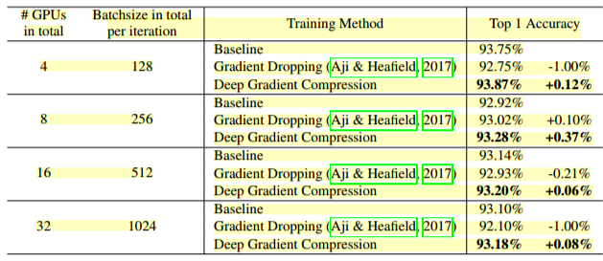
Title: DEEP GRADIENT COMPRESSION: REDUCING THE COMMUNICATION BANDWIDTH FOR DISTRIBUTED TRAINING
2018
Algorithm:
four methods: momentum correction, local gradient clipping, momentum
factor masking, and warm-up training.
Dataset: Cifar10, ImageNet, Penn Treebank,
and Librispeech Corpus dataset.
Result: ResNet-110 trained on Cifar10 Dataset
Conclusion:
Gradient Compression reduces the required
communication bandwidth and improves
the scalability of distributed training with
inexpensive,commodity networking infrastructure.

Slide 66
“Hagar Nabil”

Slide 67

1

Slide 68
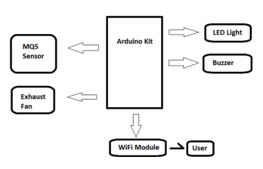
Algorithm & Model
Arduino Kit.
Gas Sensor (Mq5).
WI-FI Module.
Buzzer.
Result
Real time detection ,The MQ-5 can detect gas concentrations anywhere from 200 to 10000 ppm. As soon as the gas level has exceeded this threshold value(180ppm for the system)
Conclusion
Detecting Lp Gas ,alert with buzzer , LED screen and SMS message via WIFI-module ,Automatically control gas leak.
68

Slide 69
2
Detecting Gas Vapor Leaks Using Uncalibrated Sensors

Slide 70
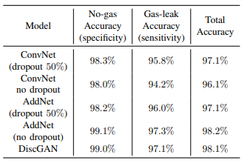
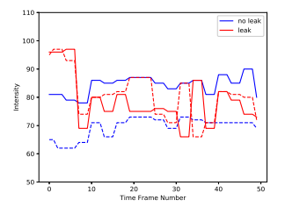
Algorithm & Model
IR Sensor , chemical gas sensors , Deep learning algorithm :
A. Convolutional Neural Network (CNN)
B. Additive Neural Networks (AddNet)
C. DcGan (Discriminator of GAN as Classifier)
Result
data set obtained at the University of California at San Diego
(UCSD), detect IR data (97%-98%)
identify gas type (96.5%)
Conclusion
variety of deep-learning based algorithms and applied them to
VOC gas and ammonia vapor leak detection and gas type
identification problems.
70

Slide 71
3
Deep Neural Networks for Source Tracking of Chemical Leaks and Improved Chemical Process Safety

Slide 72
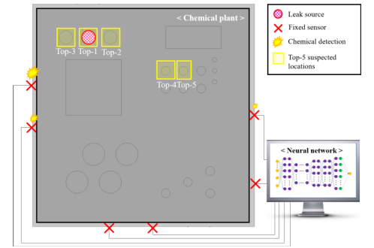
Algorithm & Model
Fixed sensors
Modelling of neural network :
Feed-forward Neural Network (FNN).
SoftMax activation function for hidden layer.
ReLU activation function.
Adam optimizer algorithm.
Result
The actual leak points were predicted with the test accuracy of 84.1% for 40 leak candidates.
Dataset : COMSOL Multiphysics 5.0 for “D” chemical plant in Yeosu, Korea by Cho (2017)
Conclusion
72

Slide 73
Early Detection System for Gas Leakage and Fire in Smart Home Using Machine Learning
4

Slide 74
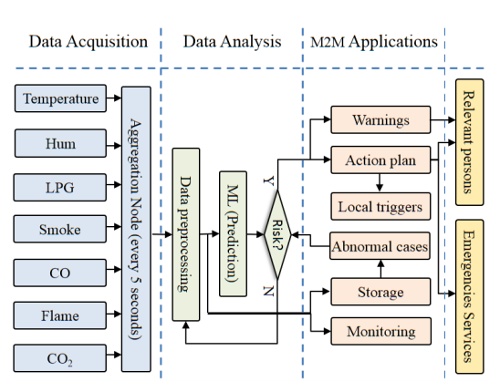
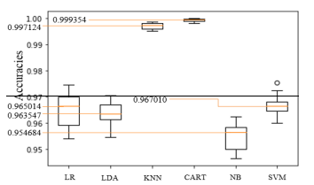
Algorithm & Model
Sensors:DHT-11,MQ-2,LM35,MG-811
classification algorithms(Supervised) :
Logistic Regression (LR)
Linear Discriminant Analysis (LDA)
K-Nearest Neighbours (KNN)
Classification and Regression Trees (CART)
Gaussian Naive Bayes (NB)
Support Vector Machines (SVM).
Result
CART is the best algorithm for the detection.
Conclusion
Observing events which are not conform to the expected pattern,
and predicting the level of risks of danger. send a notification to
alert relevant persons , analysis for the missing data by the mean avoiding fault in sensor read
74

Slide 75
Liquid Pipeline Leakage Detection Based on Moving
Windows LS-SVM Algorithm
5

Slide 76
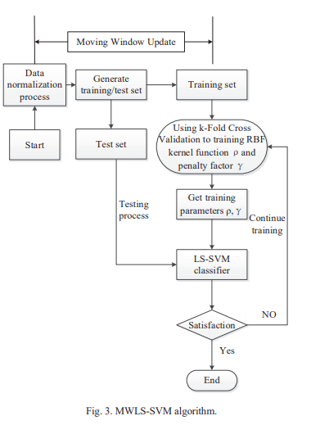
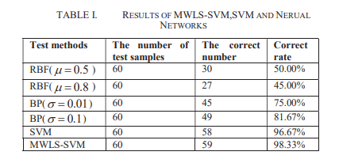
Algorithm & Model
pressure sensor
Least Squares Support Vector Machine (LS-SVM)
Using k-Fold Cross Validation to training RBF (Radial Basic Fun)
kernel function:
Linear Kernel Functions, Polynomial Kernel Functions RBF ,
kernel Functions S-type Kernel Functions
Result
The accuracy of the MWLS-SVM classifier method with K-fold cross-validation in order to get the best affect are 98.33%
Conclusion
From the simulation experiment results, we can get the
conclusion that the method of the MWLS-SVM classifier
which can improve the pipeline leakage detection accuracy.
we can locating the leakage point by the negative pressure
wave.
76

Slide 77
A New Family Monitoring Alarm System Based on Improved YOLO Network
6

Slide 78
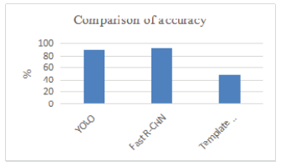
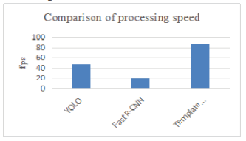
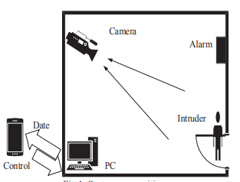
Algorithm & Model
fixed camera
Deep Learning - Convolutional Neural Network:
Template Matching
Faster-RCNN
Yolo Algorithm
Result
Conclusion
the convolution neural network is applied to the
monitoring system, it improves the YOLO network's full-link
layer and removes the resize process.
Compared with the traditional method,
the leakage detection rate and false detection rate are reduced.
78

Slide 79
Machine Learning Image Analysis for Asset Inspection
7

Slide 80
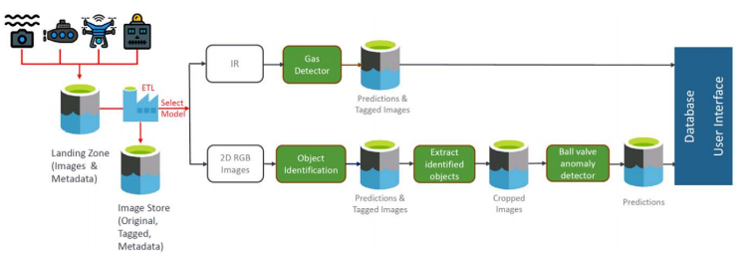
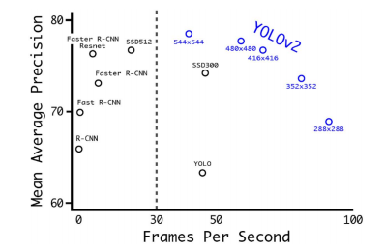
Algorithm & Model
For Gas Leak Detection ,Ball valve
IR Camera.
Anomaly detection algorithm(accuracy is 88.0%)
detecting if the ball valves open or close
Augmented original images, with no color
Transformation, YOLO V2.
Result
gas detection algorithm on the 150 unseen IR images
show a 0% FPR meaning that a gas cloud is never detected
when it doesn't exist. When a gas cloud is present,
the algorithm is able to detect it 58% of the time
Conclusion
The object detection and ball valve anomaly detection models
achieved good results, whilst the gas leak detection model
was not as successful
80

Slide 81
A Real-Time Fire Detection Method from Video with Multifeatured Fusion
8

Slide 82
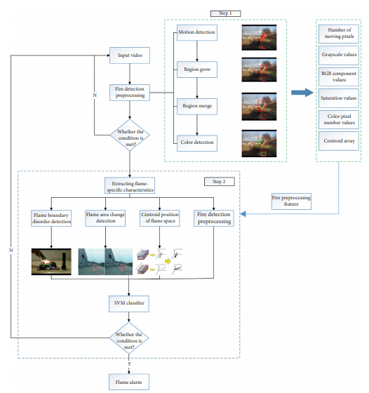
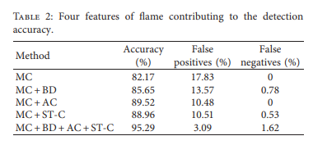
Algorithm & Model
Result
Conclusion
a new video-based flame multi-features fusion fire detection method was proposed First, the combination of motion detection and color detection greatly improved the detection speed and reduced the redundancy calculation. Second, the motion detection was based on the improved frame difference method. *ird, the fire preprocessing stage can be combined with the subsequent advanced feature extraction of the flame to reduce the calculation time
Dataset : e http://www.firedata.club, which is completely open and free for readers and researchers.
82

Slide 83
“ Khadija Serag Hamd ”

Slide 85
“Energy Demand Prediction with Federated Learning for Electric Vehicle Networks ” year: 2019
1

Slide 86
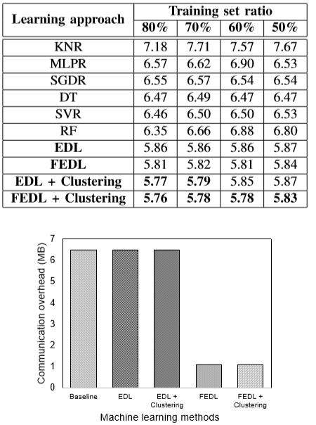
Algorithms:
they use some of algorithm :
Algorithm 1 EDL-Based Prediction Algorithm.
Algorithm 2 FEDL-Based Prediction Algorithm.
Algorithm 3 Clustering-Based EDL with Customized Constrained K-Means Algorithm.
Data set :
we use the real data obtained from charging stations in Dundee city, the dataset has 65,601 transactions which include CS ID from 58 CSs, transaction ID for each CS, EV charging date, EV charging time, and consumed energy (in kWh) for each transaction.
Conclusion:
we have proposed the novel machine learning based approaches leveraging deep learning techniques to improve the energy demand prediction accuracy and reduce the communication overhead in the EV network.
Result :

Slide 88
“Pipeline Leak Detection Using Particle Filters” year: 2015
1

Slide 89
Algorithms:
use the particle ﬁlter to estimate the pressure, mass ﬂow rate and states of the intermediate nodes.
Data set :
pipeline is of 37 km in length with 16 inch inlet diameter, divided into 19 equal divisions (20 nodes), We have total 60 variables which include pressure, mass ﬂow rate and density at each of these nodes.
Result :
the particle ﬁlter is to select the optimal number of particles.
the more the number of particles used, the better the accuracy of estimation.
There is a cost of more computational eﬀort.
improve the existing leak detection methods.
Conclusion:
the particle ﬁlter model is able to ﬁrst generate the behavior of the pipeline under normal operating conditions. Whereas, due to leak the behavior of the simulated pipeline system will change , Work is going on to improve the leak location accuracy and to make this method suitable even for smaller leaks as low as 1 percent of the nominal mass ﬂow rate.

Slide 90
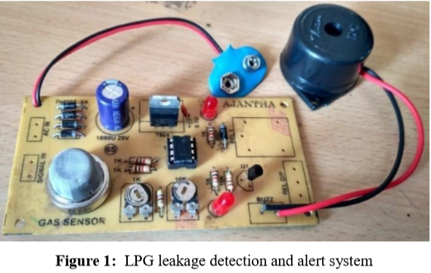
“LPG Gas Leakage Detection and Alert System” year: 2017
2

Slide 91
Algorithms:
use LPG leakage detection consists of
capacitor filter IC7805 which provides +5V regulated power supply.
To detect the LPG, MQ-6 gas sensor is employed in the range of 200-10000ppm.
The gas sensing layer of this sensor is made of Tin Dioxide (SnO2) and gold (Au) electrodes.
Data set :
designed kitchen gas leakage detection and the cylinder LPG gas .
Result :
the gas sensor is given to LM358 dual operational amplifier where it is compared with threshold value for gas density which is set using preset potentiometers and amplified.
sensed voltage is greater than the preset threshold, output fires the driver circuit for LED and Buzzer.
the LED will glow and the buzzer starts to produce alarm sound.
Conclusion:
- presented LPG leakage detection and alert system. This system triggers LED and buzzer to alert people when LPG leakage is detected.

Slide 92
“Leak detection using parameter identiﬁcation” year : 2012
3

Slide 93
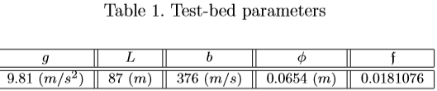
Algorithms:
Prediction Error Method (PEM).
Water Hammer equations algorithm.
Nonlinear ﬁnite models.
Linear ﬁnite model.
Data set :
pipeline available at CINVESTAV.
Result :
the frequency behavior of a pipeline can only be modeled by complex models
a frequency evaluation of approximated solutions of the Water Hammer equations has been done in order to verify the validity of the proposed identiﬁcation method.
the smallest detectable leak using mass balance methods like the considered in this paper depends on the residual.
Conclusion:
- approach based on the identiﬁcation of parameters and operation changes related with leaks. To put into practice the identiﬁcation has been essential to excite the system with a persistent input.

Slide 94
“An Investigation into the Use of Artificial Neural Network to Monitor and Detect Leakage Point(s) along a select Pipeline” year : 2013
4

Slide 95
Algorithms:
Levenberg-Marquardt algorithm which is a variation of Newton’s method that was designed for minimizing functions .
Back propagation Algorithm .
Artificial Neural Network function.
Data set :
The pipeline network segment under consideration is that which links Atlas Cove depot in Lagos state, Nigeria to Monism depot in Ogun state, Nigeria under the NNPC/PPMC Monism Area Depots. The pipeline covers a distance of 45.7km.
Result :
Levenberg-Marquardt algorithm appears to be the fastest method for training moderate-sized feed-forward neural networks as we have here.
Artificial neural network (ANN) approach to solving this identified oil leakage problem gives satisfactory results as the error between the ANN output and the target is very tolerable being 0.000566069 with a goal of 0.01.
Conclusion:
Artificial Neural Network could be used to monitor pipeline, interpret the data and provide an important leak information as well as leak(s) exact location(s).
ANN is fast with very small mean square error.

Slide 97
“Smoke Detection In Video For Early Warning Using Static And Dynamic Features ” year: 2013
1

Slide 98
Algorithms:
detecting motion area.
Smoke color detection.
Dynamic features of smoke .
Decision/Classification of smoke.
Data set :
works in smoke detection with conventional and image processing approach is as follows:
Conventional smoke detection technique use human observation, sensors, satellite, to monitor the surroundings.
Result :
classifying result , uses multiple, cooperative video sensors to provide continuous coverage of people and vehicles in a cluttered environment. For estimating the moving region they have used the adaptive background estimation and subtraction method.
Conclusion:
a smoke detection in video approach combining motion, color and dynamic features of smoke is proposed and early detection of fire smoke and can be used in indoor and outdoor area. they are taking into the consideration the static and dynamic nature of smoke for effective and accurate detection.

Slide 100
“Optimized-YOLO: Algorithm for CPU to Detect Road Traffic Accident and Alert System ” year: 2019
1

Slide 101
Algorithms:
Use Yolo algorithm achieves its result by applying a neural network on an image.
Data set :
The image is divided in SxS grid and comes up with bounding box[21].This algorithm has 24 convolutional layers which in turn has two fully connected layers. The reduction in feature space is done by Alternating 1x1 convolutional layers from preceding layers.. A single neural network can predict the bounded boxes and class probabilities directly from the input images in just one evaluation which can be optimized end-toend.
Result :
optimised-yolo algorithm is trained on custom datasets of car accident images with the map of 33.31% and the vehicle detection process has been successfully performed by the trained model vehicle detector being tested on the test data set with the live video feed from the webcam. The proposed system is faster than other object detection methods and predicts the object better other object detection algorithm such as Faster-CNN or Fast CNN.
Conclusion:
The Confidence/Model scores generated by applying a real time feed to check for accident detection by means of pb models and tensor flow, if the score reaches a threshold of 0.7 or greater then accident is detected and sms is sent. Another key indicator is the map value of the optimized Yolo.

Slide 102
“Object Recognition in Aerial Images Using Convolutional Neural Networks” year: 2017
2

Slide 103
Algorithms:
The CNN algorithm .
Result :
In Neural Network Validation:
Validation of the CNN was carried out by testing the classification accuracy on a class of objects labeled “airplanes”. The class of object “airplanes” was created by downloading satellite images of airplanes.
In Real-Time Object Recognition from UAV Video Feed:
After validation and training, network accuracy was tested in real-time video feed from the UAV flight. Additionally, detection and recognition of multi-object scenarios were also evaluated.
Conclusion:
The CNN approach for object detection and classiﬁcation in aerial images presented in this paper proved to be a highly accurate (97.8%) and efﬁcient method, This means that it can process video feeds from a UAV image acquisition system with less than 25 milliseconds of latency.
instantaneous response time allows UAVs to perform time-sensitive and complex tasks in an efﬁcient and accurate manner.
the ability for the CNN to recognize 3D image reconstructed objects must be assessed.

Slide 104
“May Esmail Mohamed”

Slide 105
Papers summary
The papers cover 4 important cases:
1)Toxic and flammable gas detection in different ways each with it’s accuracy, advantages and disadvantages moreover all ways can be combined to produce more reliable & effective product.
2) How can we use IOT technology for protection of damages caused by power faults like short circuit.
3)Pipelines fault detection methods (for gas and liquid pipelines) that fault can be blocking or leakage. their’s more than 15 ways to detect these faults each with it’s limitation, accuracy, advantages and disadvantages.
4) Real time classification of fire by a system uses image processing and robotics and many techniques for fire protection in accurate way.

Slide 106


1 ) TOXIC GAS DETECTION AND MONITORING UTILIZING INTERNET OF THINGS

Slide 107

*Result : The adjustment in, carbon monoxide, smelling salts, radiation, methane will be recognized by
separate sensors and can be resolved, (cost effective model).
*Conclusion : now we have a system for toxic gas and radiation discovery checking cautioning has been created to defeat the drawback looked in more established techniques by utilizing Wi-Fi module and IOT. Consequently the utilization of serial correspondence makes the framework with Arduino controller and IoT. The IoT door associate remote sensor connects with the web, guarantee the operation of the gas and alcohol observing framework.

Slide 108
2 ) INTERNET OF THINGS (IOT) BASED GAS LEAKAGE MONITORING AND ALERTING SYSTEM WITH MQ-6 SENSOR
*Algorithms and modules: uses ARM CORTEX M4 or Raspberry pi 3 and internet of things. Raspberry pi 3 board is used as central microcontroller which is connected with sensor Such as LPG sensor, MQ-6 gas sensor which can continuously monitor respective environmental parameters. Hence this device may be used as multi gases detection apparatus. it provides alarm if toxic gas is detected.
MQ6 can detect Iso-butane , butane and natural gas.
This paper also contain an illustration of gas sensors construction.
*Result : work presented in this project was directed towards pushing IOT technology to the next level. The principle of operation of Operation of IOT based gas leakeage and monitoring system was shown by operating the Raspbery pi 3 model attached with embedded system with required input and output gas level with the help of gas sensors was achieved. This results in a more efficient in operation because it is connected to a common free IOT based web page specially built to notify or email the responsible authority automatically so reduces the stress of constant monitoring.
Conclusion : IOT based toxic gas detector has become more efficient, more applicable than most of previous applications and smarter.

Slide 109

3 ) A Robotic Platform to Identify Gas Pipe Leakage Using IOT
*Algorithms and modules:
Result : 1. The MQ-2 gas sensor of the MQ-x family detects the gases. In order to stabilize
the sensor it is important to pre heat it.
2. When the MQ-2 sensor is exposed to the gases it will detect and then it could
send the response to the Raspberry Pi.
3. The concentration of other gases such as CO2,H2S can also be detected by
CO2 and H2S sensors respectively.

Slide 110
4. Every value recorded by the sensors is checked against a threshold value. This threshold
value is decided based upon the nature of the gases and the behaviour of the sensors.
5. We also attach a GPS Sensor to the Raspberry Pi which can detect the exact
location of the leakage.
7. An email about the focus level of gases is sent to the concerned expert as readings all the time.
Conclusion : the robot is monitored time to time with the help of the sensors and also a SMS is sent to the registered user whenever gases are present around the pipe. The designed system provides a real time and low cost solution to the gas leakage problem and prevents many accidents.

Slide 111

4 ) Gas Leakage Detection and Smart Alerting and Prediction Using IoT
Algorithms and modules: this paper proposes a system that uses components such as:

Slide 112

Result : This system is not only capable of detecting the leakages and hence presence of excess amounts of harmful gases and alerting through audible alarms but also, with the help of IoT, alerting the concerned authority about the condition before any mishap takes place through a personal call and message using GSM module, an e-mail about the details of the area using an Ethernet Shield. The system cuts off the main power supply of the house or building when the concentration of gas is about to reach its Lower Explosion Limit (LEL) which is done with the help of relays.
Conclusion: The proposed gas leakage detector is promising in the field of safety. it detects flammable and toxic gases fast and in a cost effective way.

Slide 113
5 ) Power-system protection device with IoT-based support for integration in smart environments
*Algorithms and modules:
Hardware implementation : ensures the protection of electrical consumers connected to the public power supply grid by disconnecting the electrical supply in the event of several faults: overvoltage, overcurrent, leakage current and electrical arc. as it has so many details & figures see it in the paper : https://journals.plos.org/plosone/article?id=10.1371/journal.pone.0208168#pone.0208168.ref001
*Result : prototypes, regardless of power supply type, passed all tests. Nevertheless, higher order current harmonics generated in the grid are higher in the case of switching power supply. The proposed system transcends the traditional functionalities of a classic circuit breaker not only by providing protection against additional faults but also by “becoming smart” in the sense that each protection device communicates using a concentrator-type architecture with a Web server for reporting the recorded events. The system also provides a Web-based interface for monitoring the network of operating devices and also real-time event notification through e-mail and SMS messages.

Slide 114

Conclusion: This paper described the design, implementation and functional validation of an advanced power- system protection device with IoT-based support for integration in smart environments like Smart Homes or Smart Cities. The protection device ensures the safety of electrical consumers connected to the public power supply grid by disconnecting the electrical supply in the event of several faults: overvoltage, overcurrent, leakage current and electrical arc.

Slide 115

6 ) A review on different pipeline fault detection methods
*Algorithms and modules:

Slide 116
*result :
Blockage detection techniques :
1)vibration analysis
2)Pulse echo methodology
3)Acoustic reflectometry
4)Transient wave blockage interaction and blockage detection
5)Stochastic successive linear estimator (SLE). (most appropriate)
Leakage detection techniques:
1)Negative pressure wave based leak detection system
2)Fiber sensor based leak detection
3)SVM-based pipeline leakage detection:
4)Piezoelectric AE sensor
5)Filter diagonalization method (FDM)
6) Harmonic wavelet analysis
7). Genetic algorithm (GA) in combination with the inverse transient method 8)Computational fluid dynamic simulation
*Conclusion:
this paper provides many fault detection methods for blocking and leakage and illustrates the advantage and disadvantage of each one.

Slide 117

7 ) Water Pipeline Monitoring and Leak Detection using Flow Liquid Meter Sensor
*Algorithms and modules:

Slide 118
7 ) Water Pipeline Monitoring and Leak Detection using Flow Liquid Meter Sensor
*result: the system is determining the location of the leak with a maximum distance of 2 meters and it can determine the location of the leak closest to the actual location of the leak with an average flow rate of 10 litters per minute.
*Conclusion: Arduino chip-based ATmega328P can be used to detect the location of leaks in pipes by using a data rate of water flow and the system is able to work stably to determining the location of the leak with a maximum distance of 2 meters and it can determine the location of the leak closest to the actual location of the leak with an average flow rate of 10 litters per minute.

Slide 119
8 ) Real-time probabilistic classification of fire and smoke using thermal imagery for intelligent firefighting robot
*Algorithms and modules:
the proposed method consists of extract in relevant candidates in the scene and probabilistically classifying the candidates based on statistical texture features. Images for analysis were taken using a FLIR A35 long wavelength infrared (7– 14 μm) camera with a 320 x 256-pixel focal plane array, 60 Hz frame rate that produces 14 bit images with intensity ranges between 16,384 for 40 °C and 1 for 160 °C. This camera was used since it is lightweight and can image in clear as well as zero visibility fire smoke conditions.
Pre-processing:
1)Adaptive background subtraction: Assuming that the image histogram has a bimodal distribution for background and foreground, the clustering-based image autothresholding method can calculate an optimum threshold that minimizes the weighted sum of variances of the background and foreground for their separation. A 14-bit gray-level histogram from a FLIR A35 is normalized and considered as a probability distribution.

Slide 120
*Algorithms and modules (cont.):
2)Morphological filtering and extracting candidates: . By convoluting the original 14-bit image with the filtered-binary image, an image was obtained that includes the original 14-bit intensities in candidate ROI as well as zeroes in the rest of the image.
Fire, smoke, thermal reflections and other objects classification:
1) Statistical texture features: extures of a 14-bit gray level have high-resolution spatial distribution, which is useful to recognize patterns of fire, smoke, and their thermal reflections for real time classification.
2) Bayesian classification: it was chosen due to its probabilistic decision making over multiple classes, lower chance of overfitting, and fast computation for realtime implementation. in which Supervised training was used to determine the class of the data.The candidates in the resulting Image are geometrically highlighted by colored ellipses. The class and probability of each candidate are displayed at the center of the ellipses. The red represents smoke and fire while the orange indicates a thermal reflection.
*Result : This research consists of pre-processing and classification for the purpose of firefighting robots to successfully find a fire outside the FOV. During pre-processing, candidates that have a high likelihood of being fire, smoke, or thermal reflection were extracted. During classification, statistical texture features were analyzed and the posterior probability of the five classes was estimated through Bayesian classification. The entire processing was performed using an i7, 2.5 GHz PC with a 1 GB graphic card and 8 GB of RAM. The proposed method processes each thermal image in approximately 20 ms for real-time implementation. The algorithm was developed and tested using data from three fire sources, which generate different realistic fires, temperatures

Slide 121
*Result (cont):
and smoke conditions. .In the test dataset, smoke and fire classes are classified with 93–99.9% accuracy.
*Conclusion : A real-time probabilistic classification method was developed for fire, smoke, their thermal reflections and other objects using infrared images. This algorithm was developed for use on a robot that will autonomously locate fires inside of a structure where the fire is outside the robot field of view. Thermal images were used to extract features due to the fact that long wavelength IR is capable of imaging through zero visibility environments . the proposed method differentiated between desired characteristics, such as fire and smoke, and those that may lead the robot in the incorrect direction, such as thermal reflections and other hot objects.

Slide 122

THANKS!
Any questions?

